Slide 1
Introduction to stochastic epidemic models
Jeehyun Lee
Mathematics / Computational Science & Engineering
Yonsei University

Slide 2
Objectives
Differences between deterministic and stochastic models
Advantages and disadvantages of stochastic models
Types of stochastic models
Discrete Time Markov Chain
Continuous Time Markov Chain
Stochastic Differential Equation

Slide 3
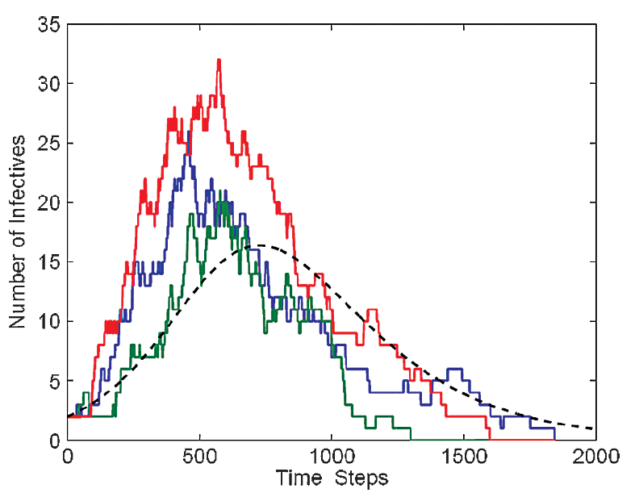
Deterministic vs stochastic model
Deterministic model describes what happens on average and do not incorporate chance fluctuations
A stochastic model includes randomness or chance
With a deterministic model, if you use the same initial conditions and parameter values, you always get the same results
With a stochastic model, you get different results each time the model is run

Slide 4

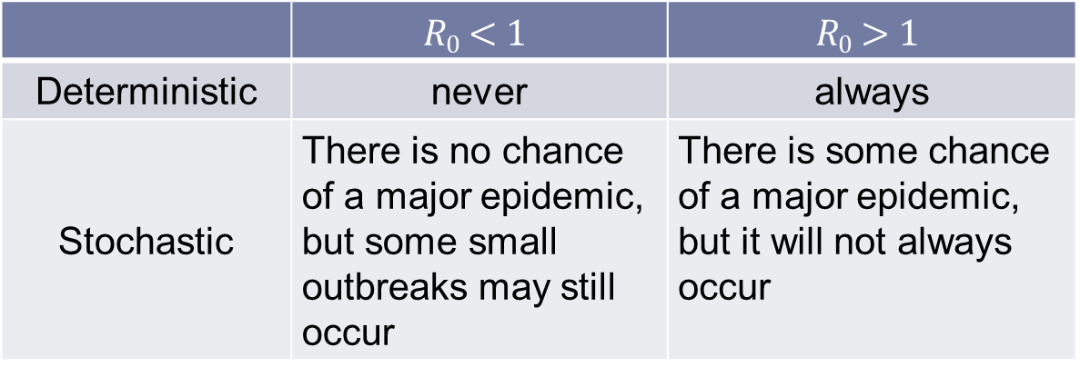
Chance of an outbreak and $R0$
 | $$R0<1$$ | $$R0>1$$
Deterministic | never | always
Stochastic | There is no chance of a major epidemic, but some small outbreaks may still occur | There is some chance of a major epidemic, but it will not always occur
Notes:
With deterministic models, when an infectious individual is introduced in a fully susceptible population,
major epidemics always occur when R0 is greater than one and never when it is less than one, which is not very realistic.
In reality, if there is one initial infectious individual may, by chance, infect no-one even when R0 is greater than one, then no epidemic would occur.
In a stochastic model, even when R0 is greater than one, sometimes the epidemic will come to an end by chance after only a small number of secondary cases
However, provided R0 is greater than one, there is also a chance that a major epidemic occurs and very large numbers are infected.
If we could do the experiment of introducing a case into a susceptible population and seeing if an epidemic occurs then we want to repeat this experiment a number of times
to get an estimate of the average behavior, and the variation in the behavior of the system that might be expected, as we expect that chance may well play a role.

Slide 5
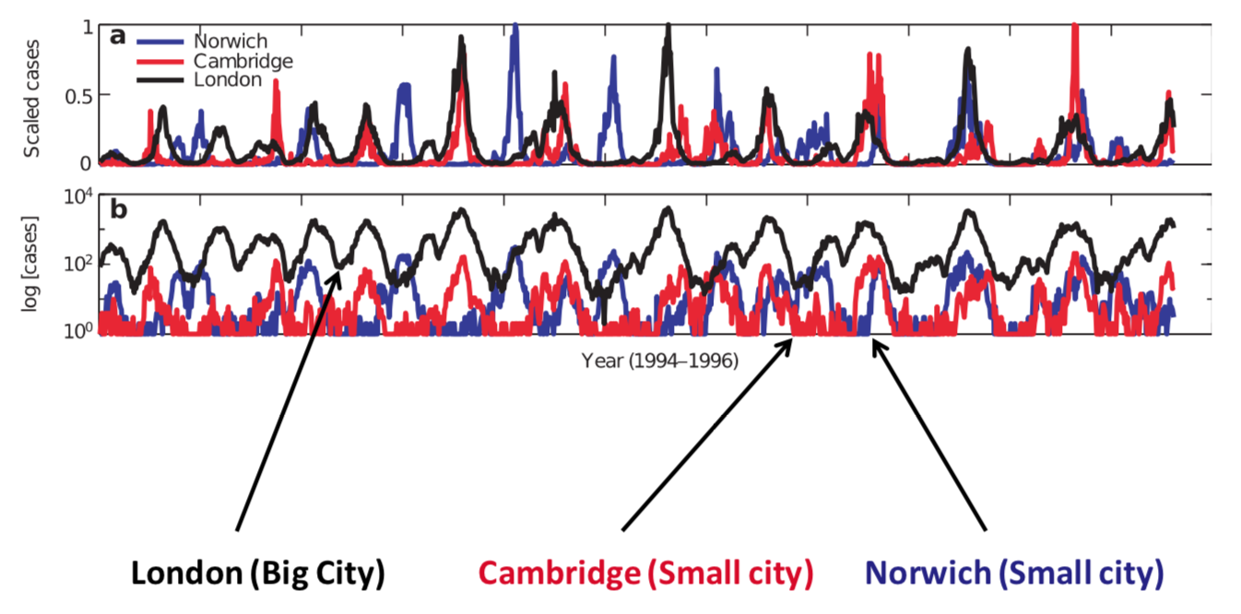
Extinction and persistence of epidemics
Measles Persists in large cities but fades out in small towns
Deterministic model cannot capture “die out” patterns
Notes:
Before vaccination against measles, it was observed that measles persisted (was always present) in large cities but faded out in smaller populations (there were periods when measles was not around).
For measles to take off again in these smaller populations it had to be re-introduced at some point after the number of susceptible had exceeded a critical density.
Clearly a deterministic model cannot properly capture these patterns as the infection always persists in a deterministic framework.
This has very real public health consequences and stochastic models may well be preferred particularly when looking at elimination and eradication.
For instance, to assess whether disease can be eradicated or to quantify how certain you would be that disease had been eliminated, given no cases had been observed for certain amount of time.

Slide 6
When are stochastic models used?
Chance may have a major role in governing the epidemiological patterns that emerge, and the variation in outcomes is important
Describing the transmission dynamics of infections in small populations, e.g. hospital epidemics
Describing transmission dynamics of infections where small numbers are infected in large populations, e.g.
- Emerging or largely eliminated diseases
- Diseases with strong seasonality
Stochastic models are also useful in exploring the critical population size or other criteria for the persistence of infection, e.g. measles

Slide 7
Advantages and disadvantages of stochastic models
They can be more realistic (incorporating chance)
- transmission doesn’t always occur
- for small populations such as at the beginning and end of an epidemic when small number of infected
They provide estimates of the variation in an outcome
not only mean but also variance in number of cases
The main disadvantage is computational
It may be necessary to run many simulations to get reasonable estimate of average results and variance

Slide 8
How to build a stochastic model?
 | Individual-based | Compartmental
Deterministic
Stochastic |  | Discrete Time Markov Chain Continuous Time Markov Chain Stochastic Differential Equation

Slide 9
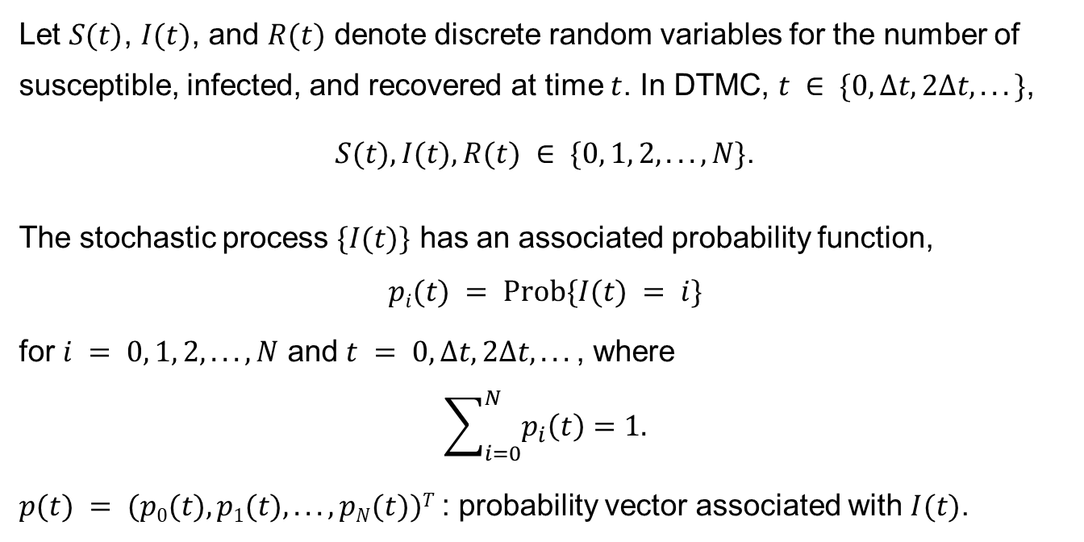
Discrete Time Markov Chain
Let $S(t)$, $I(t)$, and $R(t)$ denote discrete random variables for the number of susceptible, infected, and recovered at time $t$. In DTMC, $t ∈ \{0,Δt, 2Δt, . . .\}$,
$S(t), I(t), R(t) ∈ \{0, 1, 2, . . .,N\}$.
The stochastic process $\{I(t)\}$ has an associated probability function,
$$pi(t) = Prob\{I(t) = i\}$$
for $i = 0, 1, 2, . . .,N$ and $t = 0,Δt, 2Δt, . . .$, where
$$\sum_{i=0}^{N}{p_{i}\left(t\right)}=1.$$
$p(t) = (p0(t), p1(t), . . . , pN(t))T$: probability vector associated with $I(t)$.

Slide 10
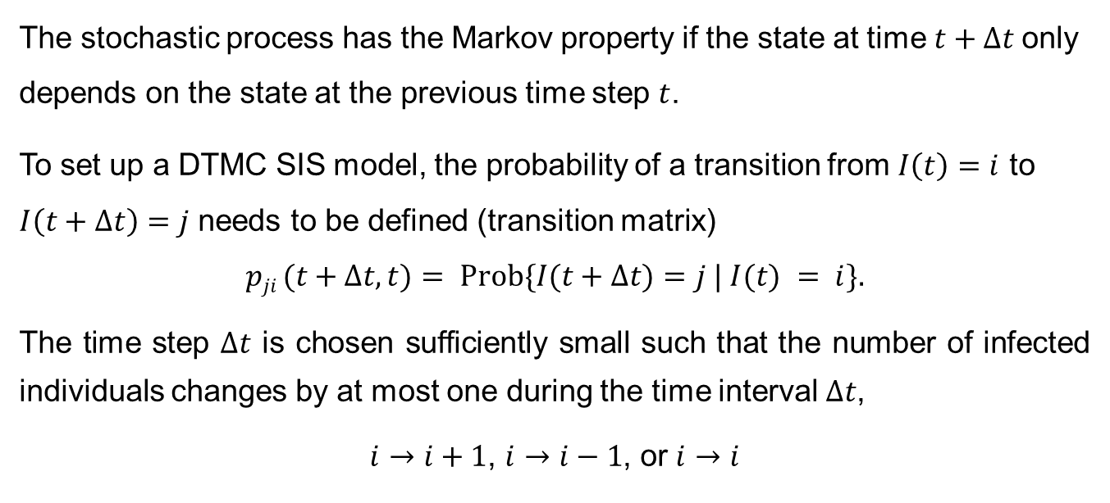
DTMC – SIS model
The stochastic process has the Markov property if the state at time $t+Δt$only depends on the state at the previous time step $t$.
To set up a DTMC SIS model, the probability of a transition from $I\left(t\right)=i$ to $I\left(t+Δt\right)=j$ needs to be defined (transition matrix)
$$pji (t+Δt,t)= Prob\{I(t+Δt)=j | I(t) = i\}.$$
The time step $Δt$ is chosen sufficiently small such that the number of infected individuals changes by at most one during the time interval $Δt$,
$i→i+1$, $i→i−1$, or $i→i$
Notes:
When the transition probability pji(t+Δt, t) does not depend on t, pji(Δt), the process is said to be time homogeneous.
For the stochastic SIS epidemic model, the process is time homogeneous because the deterministic model is autonomous.

Slide 11





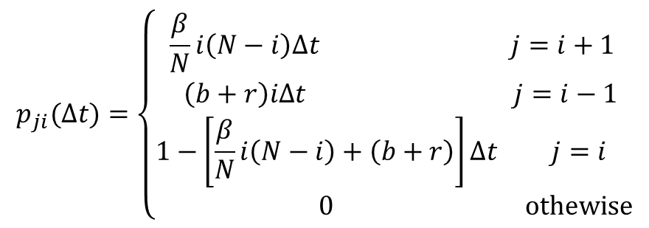


DTMC – SIS model
$$λ(t)$$
Susceptible
Infected
$$S(t)$$
$$I(t)$$
$$bN$$
$$r$$
$$b$$
$$b$$
Transition probability
$$p_{ji}(∆t)=\left\{\begin{matrix}\begin{matrix}\frac{β}{N}i\left(N−i\right)Δt & j=i+1 \\ \left(b+r\right)iΔt & j=i−1\end{matrix} \\ \begin{matrix}1−\left[\frac{β}{N}i\left(N−i\right)+\left(b+r\right)\right]Δt & j=i \\ 0 & othewise\end{matrix}\end{matrix}\right.$$

Slide 12

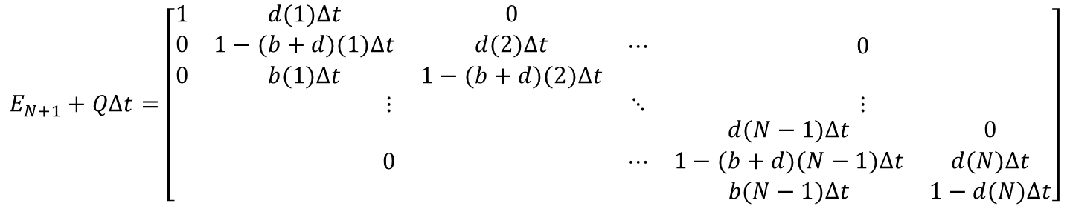

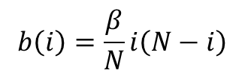
DTMC – SIS model
Transition probability
$$p_{i}(t+Δt)= p_{i−1}\left(t\right)b\left(i−1\right)Δt +p_{i}(t)\left(1−\left[b\left(i\right)+d\left(i\right)\right]Δt\right)+p_{i+1}(t)d(i+1)Δt$$
$$b\left(i\right)=\frac{β}{N}i\left(N−i\right)$$
$$d\left(i\right)=\left(b+r\right)i$$
where, and
Transition matrix
$$E_{N+1}+QΔt=\left[\begin{matrix}\begin{matrix}1 & d(1)Δt & 0 \\ 0 & 1−(b+d)(1)Δt & d(2)Δt \\ 0 & b(1)Δt & 1−(b+d)(2)Δt\end{matrix} & ⋯ & 0 \\ ⋮ & ⋱ & ⋮ \\ 0 & ⋯ & \begin{matrix}d(N−1)Δt & 0 \\ 1−(b+d)(N−1)Δt & d(N)Δt \\ b(N−1)Δt & 1−d(N)Δt\end{matrix}\end{matrix}\right]$$
$$p\left(t+Δt\right)−p\left(t\right)=Qp\left(t\right)Δt$$
where $p(0)$ is determined by the initial state.

Slide 13
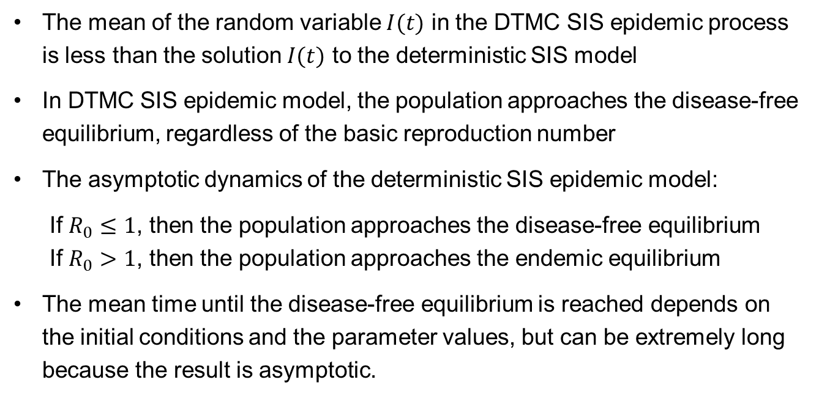
DTMC – SIS model
The mean of the random variable $I(t)$ in the DTMC SIS epidemic process is less than the solution $I(t)$ to the deterministic SIS model
In DTMC SIS epidemic model, the population approaches the disease-free equilibrium, regardless of the basic reproduction number
The asymptotic dynamics of the deterministic SIS epidemic model:
If $R_{0}≤1$, then the population approaches the disease-free equilibrium
If $R_{0}>1$, then the population approaches the endemic equilibrium
The mean time until the disease-free equilibrium is reached depends on the initial conditions and the parameter values, but can be extremely long because the result is asymptotic.

Slide 14
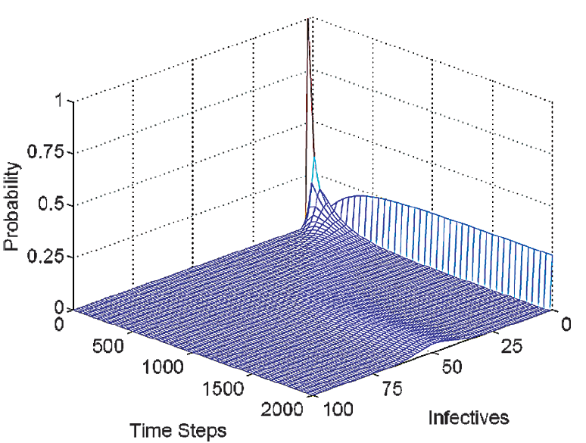
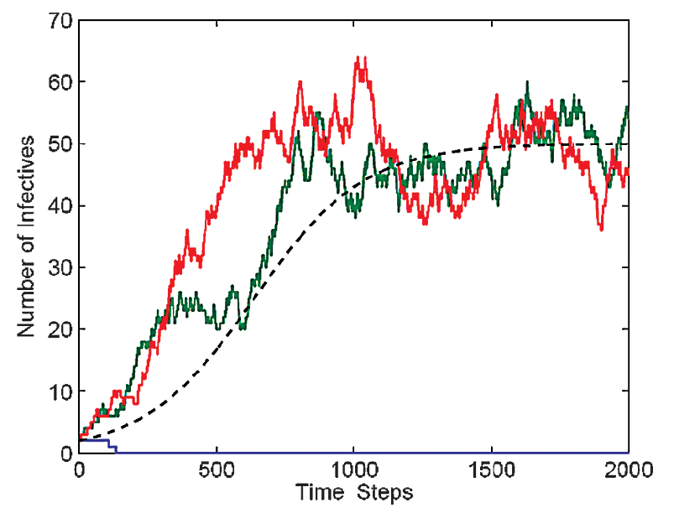
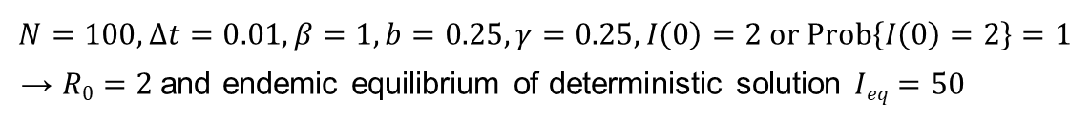
DTMC – SIS model
Numerical Example
$$N=100, Δt=0.01, β=1, b=0.25, γ=0.25, I\left(0\right)=2 or Prob\left\{I\left(0\right)=2\right\}=1$$
→ $R0=2$and endemic equilibrium of deterministic solution $Ieq=50$

Slide 15
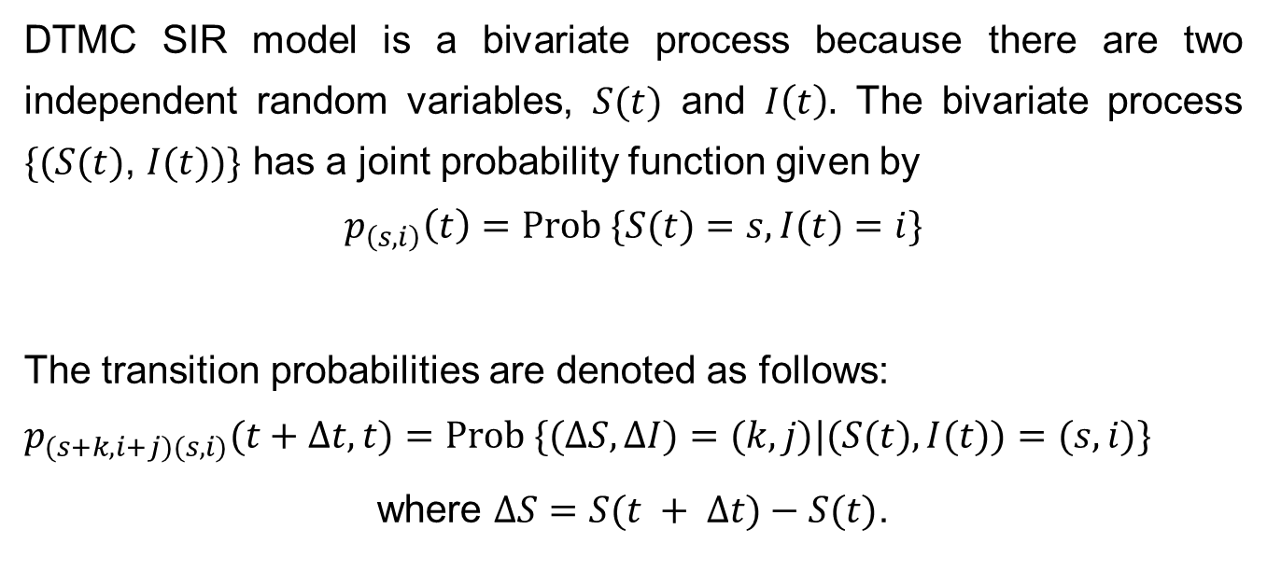
DTMC – SIR model
DTMC SIR model is a bivariate process because there are two independent random variables, $S(t)$ and $I\left(t\right).$ The bivariate process $\{(S(t)$, $I(t))\}$ has a joint probability function given by
$$p_{\left(s,i\right)}\left(t\right)=Prob \{S(t)=s, I(t)=i\}$$
The transition probabilities are denoted as follows:
$$p_{(s+k,i+j)(s,i)}(t+Δt, t)=Prob \{(ΔS, ΔI)=(k,j)|(S(t), I(t))=(s,i)\}$$
where $ΔS=S(t + Δt)−S(t)$.

Slide 16
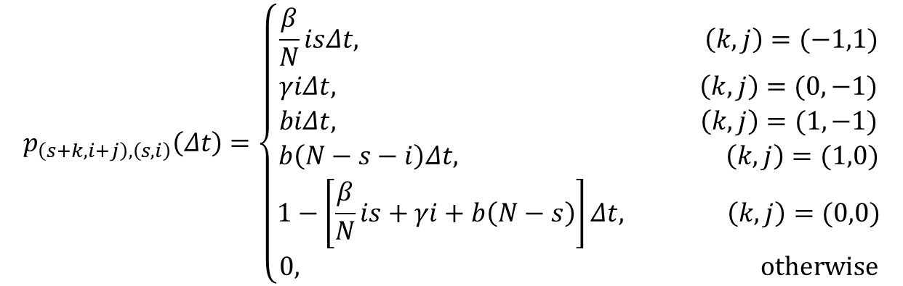
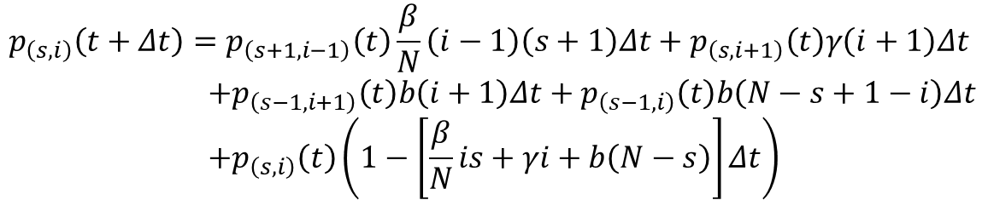
DTMC – SIR model
Transition probability
$$p_{\left(s+k,i+j\right),\left(s,i\right)}\left(Δt\right)=\left\{\begin{aligned}\frac{β}{N}isΔt, \left(k,j\right)=(−1,1) \\ γiΔt, \left(k,j\right)=(0,−1) \\ biΔt, \left(k,j\right)=(1,−1) \\ b\left(N−s−i\right)Δt, \left(k,j\right)=(1,0) \\ 1−\left[\frac{β}{N}is+γi+b\left(N−s\right)\right]Δt, \left(k,j\right)=(0,0) \\ 0, otherwise\end{aligned}\right.$$
$$p_{\left(s,i\right)}\left(t+Δt\right)=p_{\left(s+1,i−1\right)}\left(t\right)\frac{β}{N}\left(i−1\right)\left(s+1\right)Δt+p_{\left(s,i+1\right)}\left(t\right)γ\left(i+1\right)Δt \\ +p_{\left(s−1,i+1\right)}\left(t\right)b\left(i+1\right)Δt+p_{\left(s−1,i\right)}\left(t\right)b\left(N−s+1−i\right)Δt \\ +p_{\left(s,i\right)}\left(t\right)\left(1−\left[\frac{β}{N}is+γi+b\left(N−s\right)\right]Δt\right)$$

Slide 17
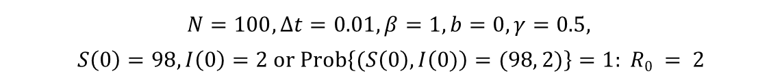
DTMC – SIR model
Numerical Example
$$N=100, Δt=0.01, β=1, b=0, γ=0.5,$$
$$S\left(0\right)=98,I\left(0\right)=2 or Prob\left\{(S\left(0\right),I\left(0)\right)=(98, 2)\right\}=1: R0 = 2$$
Notes:
Asymptotically, all sample paths eventually are absorbed into the disease-free state (N, 0). Compare this result to the deterministic SIR epidemic model.
Difference equations for the mean and higher order moments can be derived as was done for the SIS epidemic model.
However, these difference equations cannot be solved directly because they depend on higher order moments.

Slide 18
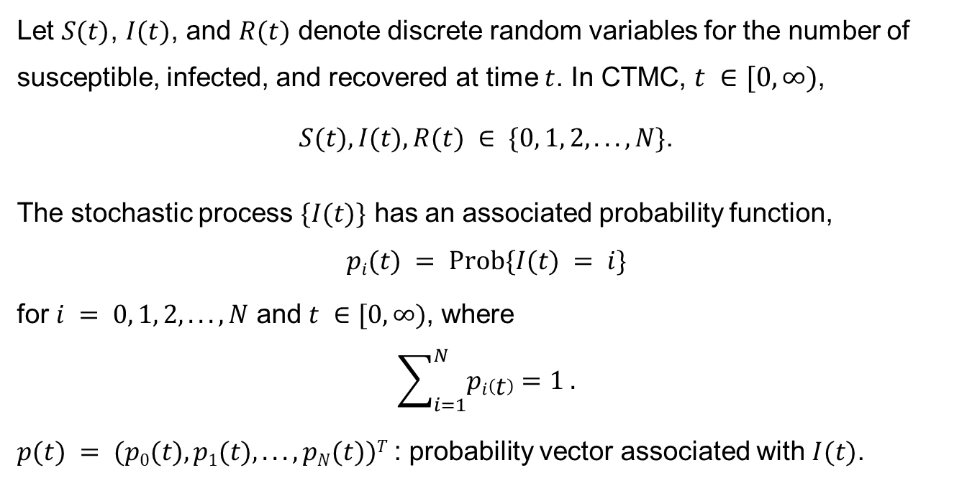
Continuous Time Markov Chain
Let $S(t)$, $I(t)$, and $R(t)$ denote discrete random variables for the number of susceptible, infected, and recovered at time $t$. In CTMC, $t ∈[0,∞)$,
$S(t), I(t), R(t) ∈ \{0, 1, 2, . . .,N\}$.
The stochastic process $\{I(t)\}$ has an associated probability function,
$$pi(t) = Prob\{I(t) = i\}$$
for $i = 0, 1, 2, . . .,N$ and $t ∈[0,∞)$, where
$$\sum_{i=1}^{N}{pi\left(t\right)=1 .}$$
$p(t) = (p0(t), p1(t), . . . , pN(t))T$: probability vector associated with $I(t)$.

Slide 19
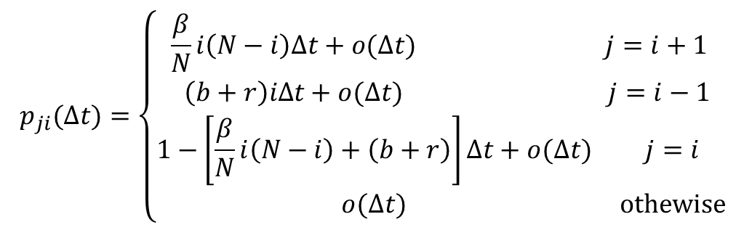
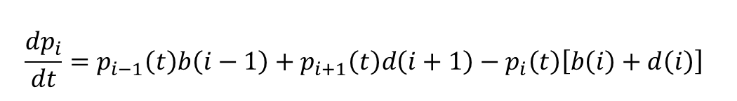
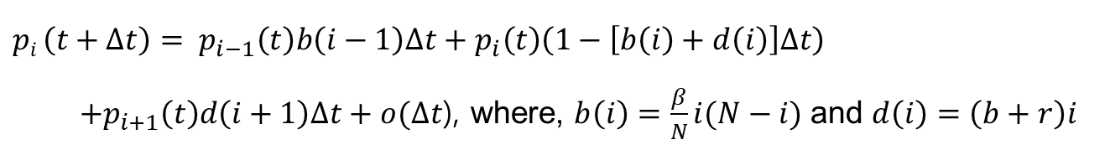
CTMC – SIS model
Infinitesimal transition probability
$$p_{ji}(∆t)=\left\{\begin{matrix}\begin{matrix}\frac{β}{N}i\left(N−i\right)Δt+o(Δt) & j=i+1 \\ \left(b+r\right)iΔt+o(Δt) & j=i−1\end{matrix} \\ \begin{matrix}1−\left[\frac{β}{N}i\left(N−i\right)+\left(b+r\right)\right]Δt+o(Δt) & j=i \\ o(Δt) & othewise\end{matrix}\end{matrix}\right.$$
$$pi \left(t+Δt\right)= p_{i−1}\left(t\right)b\left(i−1\right)Δt+p_{i}\left(t\right)\left(1−\left[b\left(i\right)+d\left(i\right)\right]Δt\right)$$
$+p_{i+1}\left(t\right)d\left(i+1\right)Δt+o(Δt$), where, $b\left(i\right)=\frac{β}{N}i(N−i)$ and $d\left(i\right)=\left(b+r\right)i$
$$\frac{{dp}_{i}}{dt}=p_{i−1}\left(t\right)b\left(i−1\right)+p_{i+1}\left(t\right)d\left(i+1\right)−p_{i}\left(t\right)\left[b\left(i\right)+d\left(i\right)\right]$$
Notes:
The transition probabilities are defined for a small time interval Δt.
But in a CTMC model, the transition probabilities are referred to as infinitesimal transition probabilities because they are valid for sufficiently small Δt.
Therefore, the term o(Δt) is included in the definition [limt→∞(o(Δt)/Δt) = 0].

Slide 20

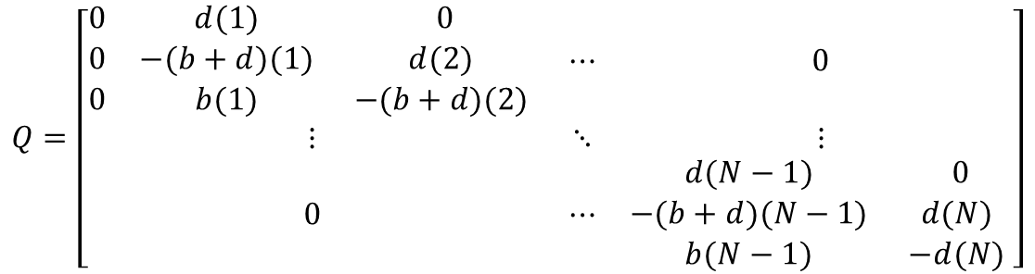

CTMC – SIS model
Forward Kolmogorov differential equations
$$\frac{dp}{dt}=Qp$$
$p\left(t\right)= \left(p_{0}\left(t\right),p_{1}\left(t\right), . . . , p_{N}\left(t\right)\right)T$ and
$$Q=\left[\begin{matrix}\begin{matrix}0 & d(1) & 0 \\ 0 & −(b+d)(1) & d(2) \\ 0 & b(1) & −(b+d)(2) \end{matrix} & ⋯ & 0 \\ ⋮ & ⋱ & ⋮ \\ 0 & ⋯ & \begin{matrix}d(N−1) & 0 \\ −(b+d)(N−1) & d(N) \\ b(N−1) & −d(N) \end{matrix}\end{matrix}\right]$$
Notes:
The transition probabilities are defined for a small time interval Δt.
But in a CTMC model, the transition probabilities are referred to as infinitesimal transition probabilities because they are valid for sufficiently small Δt.
Therefore, the term o(Δt) is included in the definition [limt→∞(o(Δt)/Δt) = 0].

Slide 21
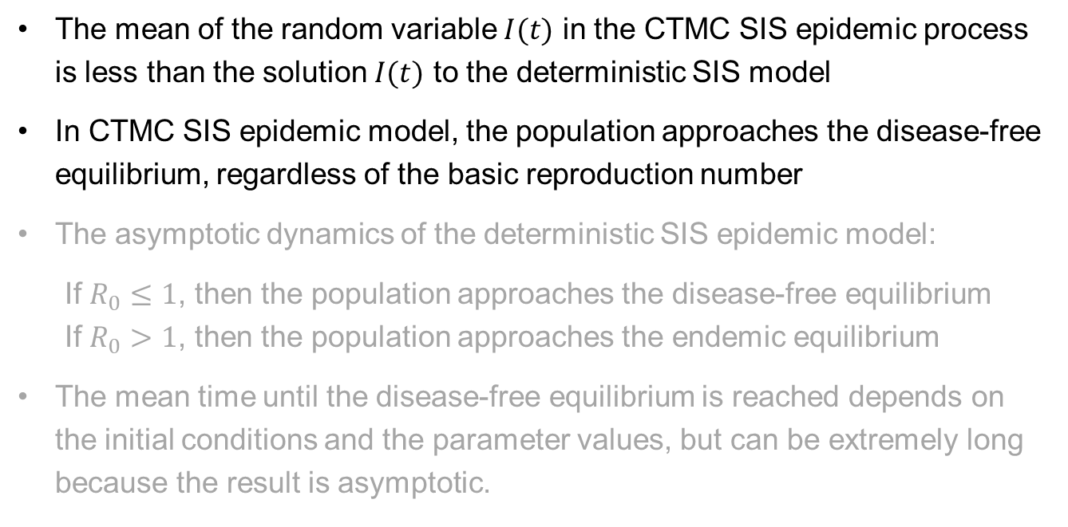
CTMC – SIS model
The mean of the random variable $I(t)$ in the CTMC SIS epidemic process is less than the solution $I(t)$ to the deterministic SIS model
In CTMC SIS epidemic model, the population approaches the disease-free equilibrium, regardless of the basic reproduction number
The asymptotic dynamics of the deterministic SIS epidemic model:
If $R_{0}≤1$, then the population approaches the disease-free equilibrium
If $R_{0}>1$, then the population approaches the endemic equilibrium
The mean time until the disease-free equilibrium is reached depends on the initial conditions and the parameter values, but can be extremely long because the result is asymptotic.

Slide 22
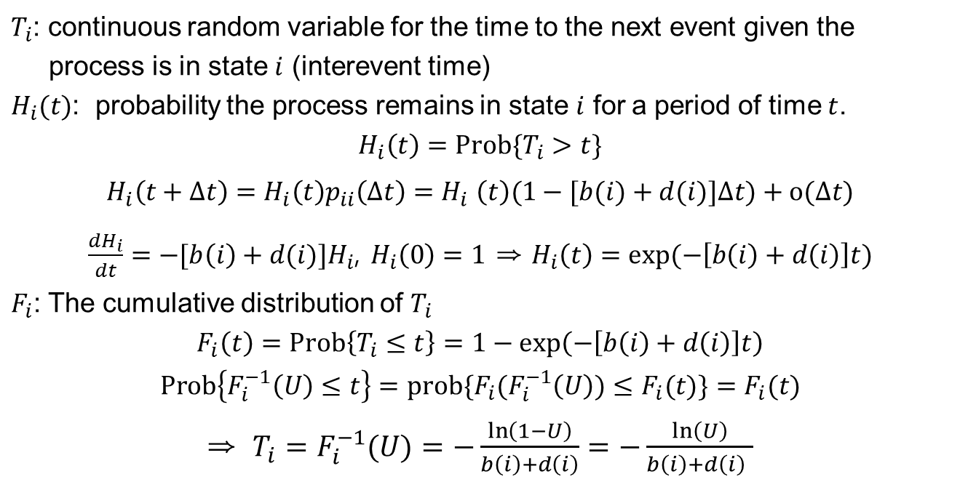
CTMC – SIS model
Gillespie algorithm
$T_{i}$: continuous random variable for the time to the next event given the
process is in state $i$ (interevent time)
$H_{i}(t)$: probability the process remains in state $i$ for a period of time $t$.
$$H_{i}\left(t\right)=Prob\{T_{i}>t\}$$
$$H_{i}\left(t+Δt\right)=H_{i}\left(t\right)p_{ii}\left(Δt\right){=H}_{i}\left(t\right)(1−[b(i)+d(i)]Δt)+o(Δt)$$
$\frac{dH_{i}}{dt}=−[b\left(i\right)+d(i)]H_{i}$, $H_{i}\left(0\right)=1$ ⇒ $H_{i}\left(t\right)=exp⁡(−\left[b\left(i\right)+d\left(i\right)\right]t)$
$F_{i}$: The cumulative distribution of $T_{i}$
$$F_{i}\left(t\right)=Prob\left\{T_{i}≤t\right\}=1−\exp\left(−\left[b\left(i\right)+d\left(i\right)\right]t\right)$$
$$Prob\left\{F_{i}^{−1}\left(U\right)≤t\right\}=prob\{{F_{i}(F}_{i}^{−1}\left(U\right))≤F_{i}(t)\}=F_{i}(t)$$
⇒ $T_{i}=F_{i}^{−1}(U)=−\frac{\ln\left(1−U\right)}{b\left(i\right)+d\left(i\right)}=−\frac{\ln\left(U\right)}{b\left(i\right)+d\left(i\right) }$
Notes:
To compute a sample path of a CTMAC model, we need to use the fact that the interevent time has an exponential distribution, which follows from the Markov property.

Slide 23
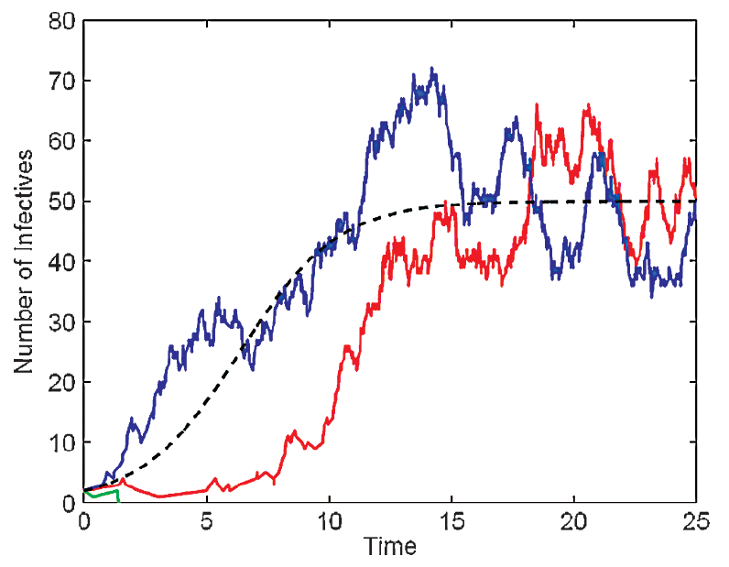
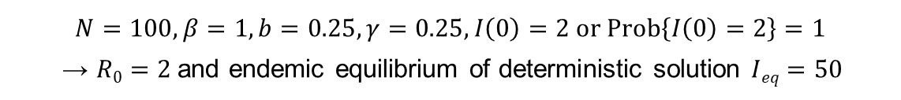
CTMC – SIS model
Numerical Example
$$N=100, β=1, b=0.25, γ=0.25, I\left(0\right)=2 or Prob\left\{I\left(0\right)=2\right\}=1$$
→ $R0=2$and endemic equilibrium of deterministic solution $Ieq=50$

Slide 24
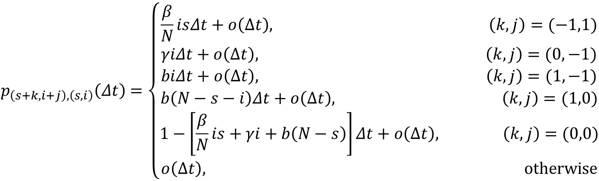
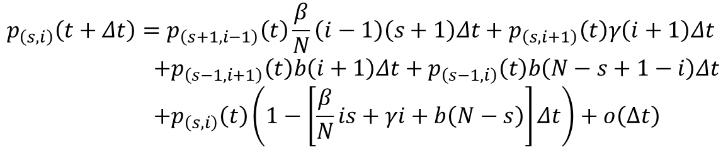
CTMC – SIR model
Infinitesimal transition probability
$$p_{\left(s+k,i+j\right),\left(s,i\right)}\left(Δt\right)=\left\{\begin{aligned}\frac{β}{N}isΔt+o\left(Δt\right), \left(k,j\right)=(−1,1) \\ γiΔt+o\left(Δt\right), \left(k,j\right)=(0,−1) \\ biΔt+o\left(Δt\right), \left(k,j\right)=(1,−1) \\ b\left(N−s−i\right)Δt+o\left(Δt\right), \left(k,j\right)=(1,0) \\ 1−\left[\frac{β}{N}is+γi+b\left(N−s\right)\right]Δt+o\left(Δt\right), \left(k,j\right)=(0,0) \\ o\left(Δt\right), otherwise\end{aligned}\right.$$
$$p_{\left(s,i\right)}\left(t+Δt\right)=p_{\left(s+1,i−1\right)}\left(t\right)\frac{β}{N}\left(i−1\right)\left(s+1\right)Δt+p_{\left(s,i+1\right)}\left(t\right)γ\left(i+1\right)Δt \\ +p_{\left(s−1,i+1\right)}\left(t\right)b\left(i+1\right)Δt+p_{\left(s−1,i\right)}\left(t\right)b\left(N−s+1−i\right)Δt \\ +p_{\left(s,i\right)}\left(t\right)\left(1−\left[\frac{β}{N}is+γi+b\left(N−s\right)\right]Δt\right)+o\left(Δt\right)$$

Slide 25
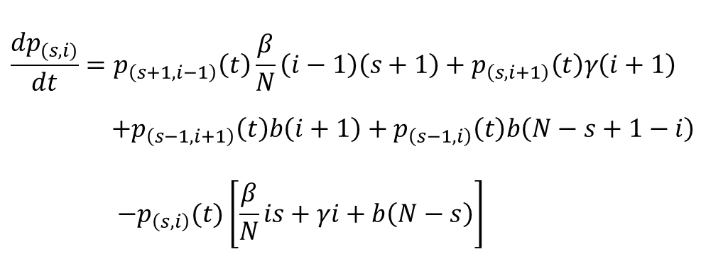
CTMC – SIR model
Kolmogorov differential equations
$$\frac{{dp}_{(s,i)}}{dt}=p_{\left(s+1,i−1\right)}\left(t\right)\frac{β}{N}\left(i−1\right)\left(s+1\right)+p_{\left(s,i+1\right)}\left(t\right)γ\left(i+1\right) \\ +p_{\left(s−1,i+1\right)}\left(t\right)b\left(i+1\right)+p_{\left(s−1,i\right)}\left(t\right)b\left(N−s+1−i\right) \\ −p_{\left(s,i\right)}(t)\left[\frac{β}{N}is+γi+b\left(N−s\right)\right]$$

Slide 26
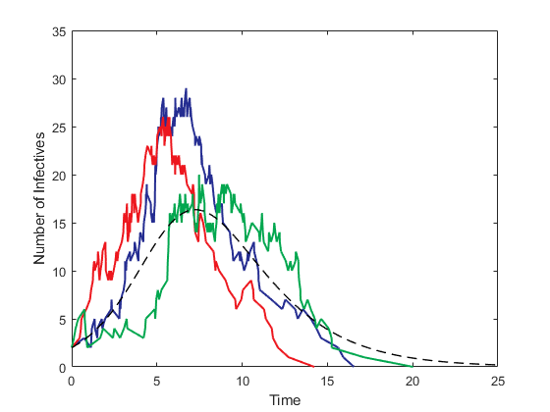
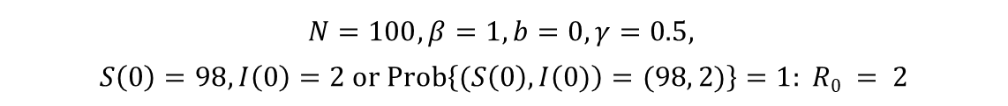
CTMC – SIR model
Numerical Example
$$N=100, β=1, b=0, γ=0.5,$$
$$S\left(0\right)=98,I\left(0\right)=2 or Prob\left\{(S\left(0\right),I\left(0)\right)=(98, 2)\right\}=1: R0 = 2$$

Slide 27
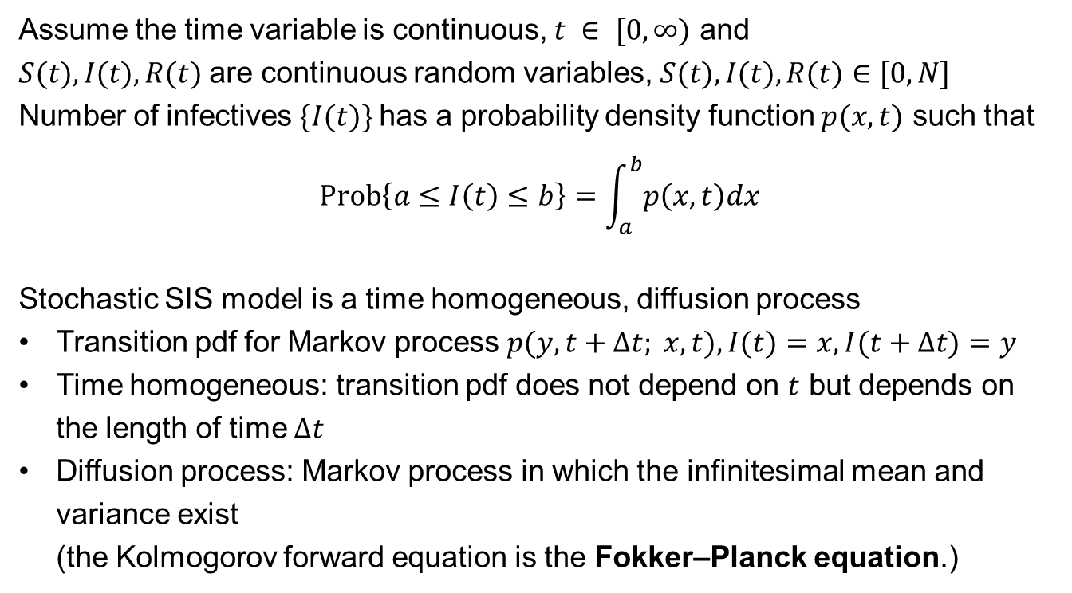
Stochastic Differential Equation
Assume the time variable is continuous, $t ∈ [0,∞)$ and
$S(t), I(t),R(t)$are continuous random variables, $S(t), I(t),R(t)∈[0,N]$
Number of infectives $\{I(t)\}$has a probability density function $p(x, t)$ such that
$$Prob\left\{a≤I\left(t\right)≤b\right\}=\int_{a}^{b}{p\left(x,t\right)dx}$$
Stochastic SIS model is a time homogeneous, diffusion process
Transition pdf for Markov process $p(y, t+Δt; x, t), I(t)=x, I(t+Δt)=y$
Time homogeneous: transition pdf does not depend on $t$ but depends on the length of time $Δt$
Diffusion process: Markov process in which the infinitesimal mean and variance exist (the Kolmogorov forward equation is the Fokker–Planck equation.)

Slide 28
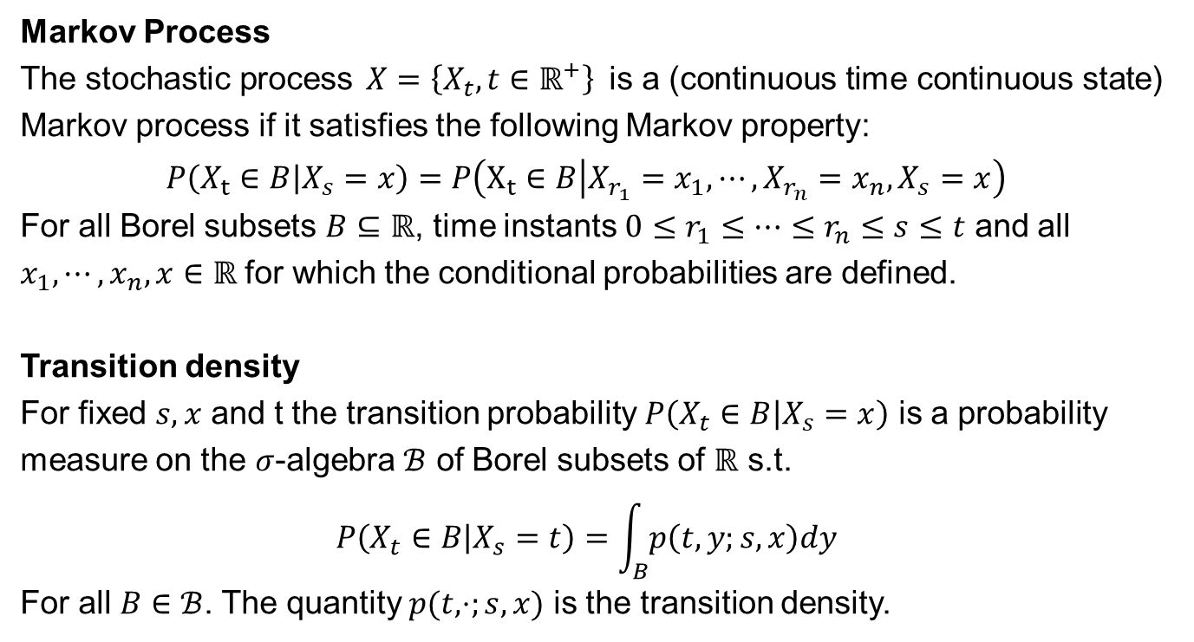
Stochastic Differential Equation
Markov Process
The stochastic process $X=\left\{X_{t},t∈ℝ^{+}\right\}$ is a (continuous time continuous state) Markov process if it satisfies the following Markov property:
$$P\left(X_{t}∈B | X_{s}=x\right)=P\left(X_{t}∈B | X_{r_{1}}=x_{1}, ⋯,X_{r_{n}}=x_{n}, X_{s}=x\right)$$
For all Borel subsets $B⊆ℝ$, time instants $0≤r_{1}≤⋯≤r_{n}≤s≤t$ and all $x_{1}, ⋯, x_{n},x∈ℝ$ for which the conditional probabilities are defined.
Transition density
For fixed $s,x$ and t the transition probability $P\left(X_{t}∈B | X_{s}=x\right)$ is a probability measure on the $σ$-algebra $ℬ$ of Borel subsets of $ℝ$ s.t.
$$P\left(X_{t}∈B | X_{s}=t\right)=\int_{B}{p\left(t,y;s,x\right)dy}$$
For all $B∈ℬ$. The quantity $p(t,⋅;s,x)$ is the transition density.

Slide 29
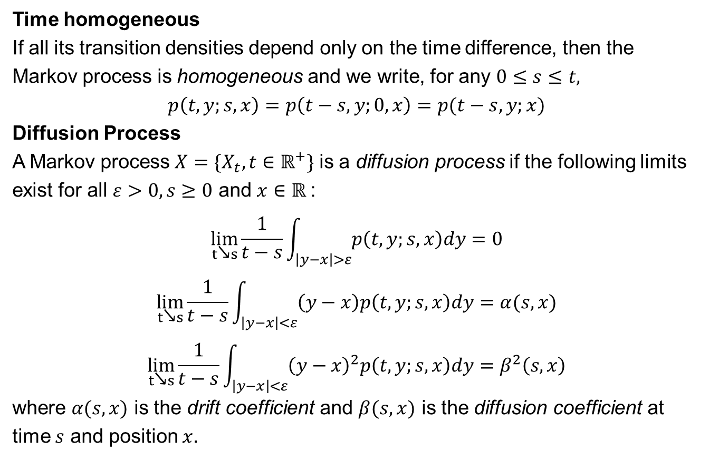
Stochastic Differential Equation
Time homogeneous
If all its transition densities depend only on the time difference, then the Markov process is homogeneous and we write, for any $0≤s≤t,$
$$p\left(t,y;s,x\right)=p\left(t−s,y;0,x\right)=p(t−s,y;x)$$
Diffusion Process
A Markov process $X=\{X_{t},t∈ℝ^{+}\}$ is a diffusion process if the following limits exist for all $ε>0, s≥0$ and $x∈ℝ$:
$$\lim_{t↘s}\frac{1}{t−s}\int_{\left|y−x\right|>ε}{p\left(t,y;s,x\right)dy}=0$$
$$\lim_{t↘s}\frac{1}{t−s}\int_{\left|y−x\right|<ε}{\left(y−x\right)p\left(t,y;s,x\right)dy}=α(s,x)$$
$$\lim_{t↘s}\frac{1}{t−s}\int_{\left|y−x\right|<ε}{{\left(y−x\right)}^{2}p\left(t,y;s,x\right)dy}=β^{2}\left(s,x\right)$$
where $α(s,x)$ is the drift coefficient and $β(s,x)$ is the diffusion coefficient at time $s$ and position $x.$

Slide 30
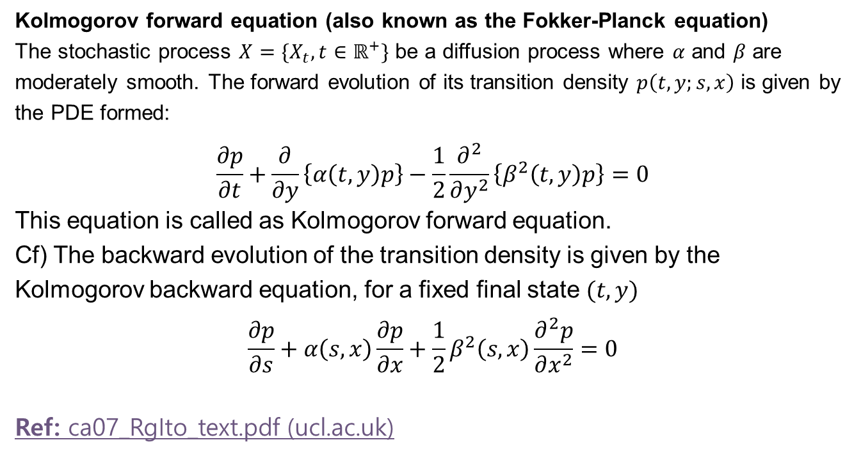
Stochastic Differential Equation
Kolmogorov forward equation (also known as the Fokker-Planck equation)
The stochastic process $X=\{X_{t},t∈ℝ^{+}\}$ be a diffusion process where $α$ and $β$ are moderately smooth. The forward evolution of its transition density $p\left(t,y;s,x\right)$ is given by the PDE formed:
$$\frac{∂p}{∂t}+\frac{∂}{∂y}\left\{α\left(t,y\right)p\right\}−\frac{1}{2}\frac{∂^{2}}{∂y^{2}}\left\{β^{2}\left(t,y\right)p\right\}=0$$
This equation is called as Kolmogorov forward equation.
Cf) The backward evolution of the transition density is given by the Kolmogorov backward equation, for a fixed final state $(t,y)$
$$\frac{∂p}{∂s}+α\left(s,x\right)\frac{∂p}{∂x}+\frac{1}{2}β^{2}\left(s,x\right)\frac{∂^{2}p}{∂x^{2}}=0$$
Ref: ca07_RgIto_text.pdf (ucl.ac.uk)

Slide 31
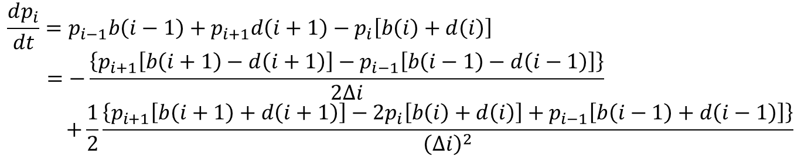

SDE - SIS model
$$Prob\left\{I\left(0\right)= i0\right\}=1, p_{i}\left(t\right)≔p\left(t, i;0, i_{0}\right)=p\left(t, i\right), Δi=1$$
$$i=x, Δi=Δx , p_{i}(t)=p(x, t) and Δx → 0$$
$$\frac{dp_{i}}{dt}=p_{i−1}b\left(i−1\right)+p_{i+1}d\left(i+1\right)−p_{i}\left[b\left(i\right)+d\left(i\right)\right] \\ =−\frac{\left\{p_{i+1}\left[b\left(i+1\right)−d\left(i+1\right)\right]−p_{i−1}\left[b\left(i−1\right)−d\left(i−1\right)\right]\right\}}{2Δi} \\ +\frac{1}{2}\frac{\left\{p_{i+1}\left[b\left(i+1\right)+d\left(i+1\right)\right]−2p_{i}\left[b\left(i\right)+d\left(i\right)\right]+p_{i−1}\left[b\left(i−1\right)+d\left(i−1\right)\right]\right\}}{{\left(Δi\right)}^{2}}$$
$$\frac{∂p\left(x,t\right)}{∂t}=−\frac{∂}{∂x}\left\{\left[b\left(x\right)−d\left(x\right)\right]p\left(x,t\right)\right\}+\frac{1}{2}\frac{∂^{2}}{∂x^{2}}\left\{\left[b\left(x\right)+d\left(x\right)\right]p\left(x,t\right)\right\}$$
$$\frac{∂p\left(x,t\right)}{∂t}=−\frac{∂}{∂x}\left\{\left[\frac{β}{N}x\left(N−x\right)−\left(b+γ\right)x\right]p\left(x,t\right)\right\}+\frac{1}{2}\frac{∂^{2}}{∂x^{2}}\left\{\left[\frac{β}{N}x\left(N−x\right)+\left(b+γ\right)x\right]p\left(x,t\right)\right\}$$
mean
variance

Slide 32
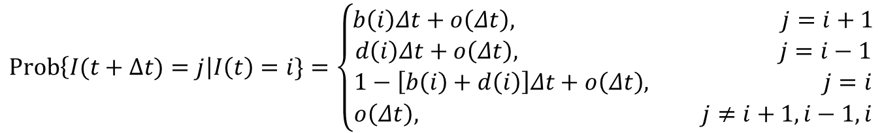

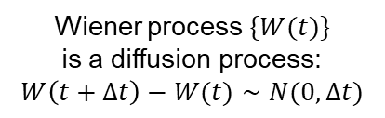
SDE - SIS model
CTMC SIS model:
$$E\left(ΔI\right)=b\left(I\right)Δt −d\left(I\right)Δt+o\left(Δt\right)=μ\left(I\right)Δt+o(Δt)$$
$$Var\left(ΔI\right)=E\left(ΔI\right)2 −\left[E\left(ΔI\right)\right]2=b\left(I\right)Δt+d\left(I\right)Δt+o\left(Δt\right)=σ2 (I)Δt+o(Δt)$$
Assume that $ΔI$ is normally distributed: $ΔI(t)∼N(μ(I)Δt, σ2(I)Δt)$
$$Prob\left\{I(t+Δt)=j\right|I\left(t\right)=i\}=\left\{\begin{aligned}b\left(i\right)Δt+o\left(Δt\right), j=i+1 \\ d\left(i\right)Δt+o\left(Δt\right), j=i−1 \\ 1−\left[b\left(i\right)+d\left(i\right)\right]Δt+o\left(Δt\right), j=i \\ o\left(Δt\right), j≠i+1,i−1,i\end{aligned}\right.$$
$$I\left(t+Δt\right)=I\left(t\right)+ΔI\left(t\right)≅I\left(t\right)+μ\left(I\right)Δt+σ\left(I\right)\sqrt{Δt} η, η\sim N\left(0,1\right).$$
Wiener process $\{W(t)\}$
is a diffusion process:
$$W\left(t+Δt\right)−W(t)∼N(0,Δt)$$

Slide 33

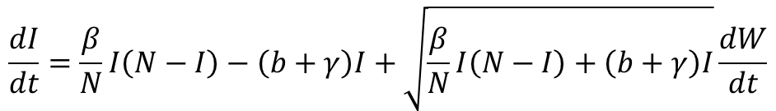

SDE - SIS model
$$μ\left(I\right)=b\left(I\right)−d\left(I\right), σ\left(I\right)=\sqrt{b\left(I\right)+d\left(I\right)}, b\left(I\right)=\frac{β}{N}I\left(N−I\right) and d(I)=(b+γ)I$$
$$I\left(t+Δt\right)=I\left(t\right)+ΔI\left(t\right)≅I\left(t\right)+μ\left(I\right)Δt+σ\left(I\right)\sqrt{Δt} η, η\sim N\left(0,1\right).$$
$$\frac{dI}{dt}=μ\left(I\right)+σ\left(I\right)\frac{dW}{dt}$$
$$\frac{dI}{dt}=\frac{β}{N}I\left(N−I\right)−\left(b+γ\right)I+\sqrt{\frac{β}{N}I\left(N−I\right)+\left(b+γ\right)I}\frac{dW}{dt}$$

Slide 34
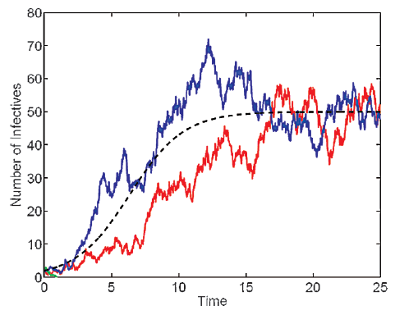
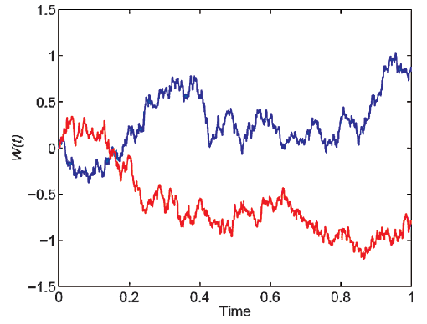
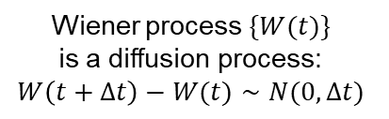
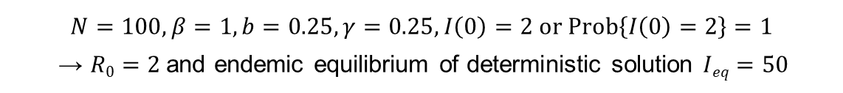
SDE – SIS model
Numerical Example
Wiener process $\{W(t)\}$
is a diffusion process:
$$W\left(t+Δt\right)−W(t)∼N(0,Δt)$$
$$N=100, β=1, b=0.25, γ=0.25, I\left(0\right)=2 or Prob\left\{I\left(0\right)=2\right\}=1$$
→ $R0=2$and endemic equilibrium of deterministic solution $Ieq=50$

Slide 35

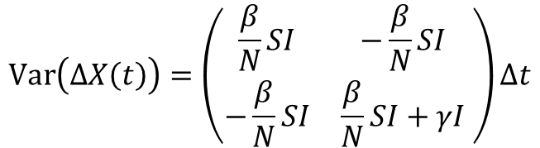

SDE – SIR model
Let $ΔX\left(t\right)=(ΔS,ΔI)T$and we assume $b=0$ for simplicity.
$$Var\left(ΔX\left(t\right)\right)=𝔼\left(ΔX\left(t\right)\left[ΔX\left(t\right)\right]T \right)−𝔼\left(ΔX\left(t\right)\right)𝔼\left(ΔX\left(t\right)\right)T ≈𝔼\left(ΔX\left(t\right)\left[ΔX\left(t\right)\right]T \right)$$
$$p_{\left(s+k,i+j\right),\left(s,i\right)}\left(Δt\right)=\left\{\begin{aligned}\frac{β}{N}isΔt, \left(k,j\right)=(−1,1) \\ γiΔt, \left(k,j\right)=(0,−1) \\ biΔt, \left(k,j\right)=(1,−1) \\ b\left(N−s−i\right)Δt, \left(k,j\right)=(1,0) \\ 1−\left[\frac{β}{N}is+γi+b\left(N−s\right)\right]Δt, \left(k,j\right)=(0,0) \\ 0, otherwise\end{aligned}\right.$$
$$𝔼\left(ΔX\left(t\right)\right)=\left({−\frac{β}{N}SI \atop \frac{β}{N}SI−γI}\right)Δt$$
$$Var\left(ΔX\left(t\right)\right)=\left(\begin{matrix}\frac{β}{N}SI & −\frac{β}{N}SI \\ −\frac{β}{N}SI & \frac{β}{N}SI+γI\end{matrix} \right)Δt$$

Slide 36
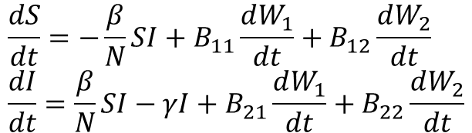
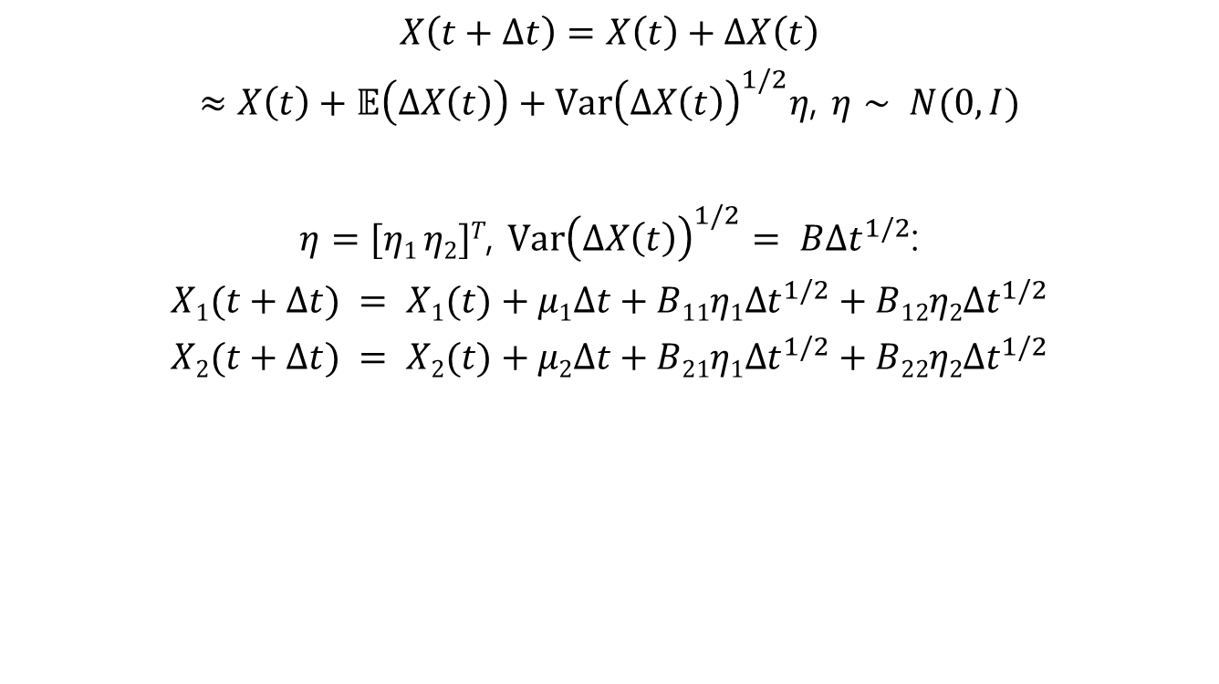
SDE – SIR model
$$X\left(t+Δt\right)=X\left(t\right)+ΔX\left(t\right)$$
$≈X\left(t\right)+𝔼\left(ΔX\left(t\right)\right)+{Var\left(ΔX\left(t\right)\right)}^{1/2}η$, $η∼ N(0, I)$
$η=[η1 η2]T$, ${Var\left(ΔX\left(t\right)\right)}^{1/2}= B{Δt}^{1/2}$:
$$X1(t+Δt) = X1(t)+μ1Δt+B11η1{Δt}^{1/2}+B12η2{Δt}^{1/2}$$
$$X2(t+Δt) = X2(t)+μ2Δt+B21η1{Δt}^{1/2}+B22η2{Δt}^{1/2}$$
$$\frac{dS}{dt}=−\frac{β}{N}SI+B_{11}\frac{dW_{1}}{dt}+B_{12}\frac{dW_{2}}{dt} \\ \frac{dI}{dt}=\frac{β}{N}SI−γI+B_{21}\frac{dW_{1}}{dt}+B_{22}\frac{dW_{2}}{dt}$$

Slide 37


SDE – SIR model
Numerical Example
$$N=100, Δt=0.01, β=1, b=0, γ=0.5,$$
$$S\left(0\right)=98,I\left(0\right)=2 or Prob\left\{(S\left(0\right),I\left(0)\right)=(98, 2)\right\}=1: R0 = 2$$

Slide 38


Probability of an Outbreak
$X(t)$ be the random variable for the position at time $t$,
there is either a move to the right $x→x+1$with probability $p$ or
a move to the left, $x→x−1$with probability $q$, in the next time interval
with the exception of state $0$, where there is no movement .
In the random walk, either the process approaches state $0$ or $∞$.
Let $X(t)=x0>0$, then the probability of absorption into state $0$ is
Cf) gambler’s ruin with finite assets and change it with infinite assets.
$$\lim_{t→∞}{Prob\left\{X\left(t\right)=0\right\}=\left\{\begin{aligned}1, if p≤q \\ {\left(\frac{q}{p}\right)}^{x_{0}}, if p>q\end{aligned}\right.}$$
(*)

Slide 39


Probability of an Outbreak
In the linear birth and death process, the infinitesimal transition probabilities satisfy
The probability of absorption is one if $λ≤μ$.
But if $λ>μ$ the probability of absorption decreases to ${(μ/λ)}^{x_{0}}$.
In this case, the probability of population persistence is $1− {(μ/λ)}^{x_{0}}$. This identity can be used to approximate the probability of an outbreak in the DTMC and CTMC epidemic models, where population persistence can be interpreted as an outbreak.
$$p_{i+j,i}\left(Δt\right)=\left\{\begin{aligned}λiΔt+o\left(Δt\right), j=1 \\ μiΔt+o\left(Δt\right), j=−1 \\ 1−\left(λ+μ\right)iΔt+o\left(Δt\right), j=0\end{aligned}\right.$$

Slide 40




Probability of an Outbreak
Suppose the initial number of infected individuals $i0$ is small and the population size $N$ is large. Then the birth and death functions in an SIS epidemic model are given by
Applying the identity leads to $μ/λ=(b + γ)/β=1/R0$
$$Birth=b\left(i\right)=\frac{β}{N}i\left(N−i\right)≅βi$$
$$Death=d\left(i\right)=\left(b+γ\right)i$$
$$\lim_{t→∞}Prob\left\{I\left(t\right)=0\right\}≅\left\{\begin{aligned}1, if ℛ_{0}≤1 \\ {\left(\frac{1}{ℛ_{0}}\right)}^{i_{0}}, if ℛ_{0}>1\end{aligned}\right.$$

Slide 41


Probability of an Outbreak
$$Probability of an Outbreak≅\left\{\begin{aligned}0, if ℛ_{0}≤1 \\ 1−{\left(\frac{1}{ℛ_{0}}\right)}^{i_{0}}, if ℛ_{0}>1\end{aligned}\right.$$
The estimates apply to the stochastic epidemic models only for a
range of times, $t∈[T1,T2]$. In the stochastic models$, {lim⁡}_{t→∞}Prob\{I(t) =0\}=1$because $0$ is an absorbing state. The range of times for which the estimate holds can be quite long when N is large and $i0$ is small.

Slide 42

Probability of an Outbreak
DTMC SIS epidemic model

Slide 43

Quasi-stationary Probability Distribution
Because the zero state in the stochastic SIS epidemic models is absorbing, the unique stationary distribution approached asymptotically by the stochastic process is the disease-free equilibrium. However, prior to absorption, the process approaches what appears to be a stationary distribution that is different from the disease-free equilibrium. This distribution is known as the quasi-stationary probability distribution.
Let the distribution $q\left(t\right)$ conditioned on nonextinction for the CTMC SIS epidemic model be denoted as $q(t)=\left(q_{1}\left(t\right), . . . , q_{N}\left(t\right)\right)T.$
$$p_{i}\left(t\right)=Prob\{I\left(t\right)=i | I(s)>0, t>s\}$$
Because the $0$ state is absorbing,
$$Prob\left\{I\left(t\right)>0|I\left(s\right)>0, t>s\right\}= 1− p0(t).$$
PII: S0025-5564(99)00047-4 (hawaii.edu)

Slide 44






Quasi-stationary Probability Distribution
Cf) $\frac{p_{i}}{1−p_{0}\left(t\right)}\frac{p_{0}^{′}\left(t\right)}{1−p_{0}(t)}=\frac{p_{i}}{1−p_{0}\left(t\right)}\frac{p_{1}d\left(1\right)}{1−p_{0}\left(t\right)}=d\left(1\right)q_{1}q$
$$q_{i}\left(t\right)=\frac{p_{i}\left(t\right)}{1−p_{0}\left(t\right)}, i=1,2,⋯,N.$$
$$\frac{dq_{i}}{dt}=\frac{dp_{i}/dt}{1−p_{0}}+\left(b+γ\right)q_{1}\frac{p_{i}}{1−p_{0}}$$
$$\frac{dq}{dt}=\tilde{Q}q+\left(b+γ\right)q_{1}q,$$
$$\tilde{Q}=\left(\begin{matrix}−\left[b\left(1\right)+d\left(1\right)\right] & d\left(2\right) & ⋯ & 0 \\ b\left(1\right) & −\left[b\left(2\right)+d\left(2\right)\right] & ⋯ & 0 \\ 0 & b\left(2\right) & ⋯ & 0 \\ ⋮ & ⋮ & ⋮ & ⋮ \\ 0 & 0 & ⋯ & d\left(N\right) \\ 0 & 0 & ⋯ & −d\left(N\right)\end{matrix}\right)$$
The quasi-stationary probability distribution $q^{∗} = (q_{1}^{∗}, . . . ,q_{N}^{∗})T$satisfies
$$\tilde{Q}q^{∗}=−\left(b+γ\right)q_{1}^{∗}q^{∗}.$$

Slide 45

Quasi-stationary Probability Distribution
Fig. 3.12 Exact quasi-stationary distribution and the approximation to the quasi-stationary distribution for $R0$ =1.5, 2, and 3 when N = 50

Slide 46





Final Size of an Epidemic
Final size = total number of cases during the course of the epidemic
If the epidemic is short term, we assume that there are no births nor deaths.
In the deterministic SIR model,
$$\frac{dI}{dS}=−1+\frac{γ}{\frac{β}{N}S} (let b=0)$$
$$\frac{dS}{dt}=−\frac{β}{N}SI+b\left(I+R\right) \\ \frac{dI}{dt}=\frac{β}{N}SI−\left(b+γ\right)I \\ \frac{dR}{dt}=γI−bR$$
$$I\left(t\right)+S\left(t\right)=I\left(0\right)+S\left(0\right)+\frac{Nγ}{β}\ln\left(\frac{S\left(t\right)}{S\left(0\right)}\right)$$
$$S\left(∞\right)=I\left(0\right)+S\left(0\right)+\frac{Nγ}{β}\ln\left(\frac{S\left(∞\right)}{S\left(0\right)}\right)$$
$$R\left(∞\right)=N\left(∞\right)−S\left(∞\right)$$

Slide 47



Final Size of an Epidemic
Suppose $N=3$, then states
$$(s, i)∈\{(3, 0), (2, 0), (1, 0), (0, 0), (2, 1), (1, 1), (0, 1), (1, 2), (0, 2), (0, 3)\}$$
Types of transition
$$(s, i) → (s, i−1)$$
$$(s, i) → (s−1, i+1)$$
$1−p_{s}$
Distribution for the final size can
be found from ${lim⁡}_{t→∞}T^{k}p(0)$
$$T=\left(\begin{matrix}1 & 0 & 0 & 0 & & 0 & & 0 & & 0 & & 0 & & 0 & & 0 \\ 0 & 1 & 0 & 0 & & p_{2} & & 0 & & 0 & & 0 & & 0 & & 0 \\ 0 & 0 & 1 & 0 & & 0 & & p_{1} & & 0 & & 0 & & 0 & & 0 \\ 0 & 0 & 0 & 1 & & 0 & & 0 & & p_{0} & & 0 & & 0 & & 0 \\ − & − & − & − & & − & & − & & − & & − & & − & & − \\ 0 & 0 & 0 & 0 & & 0 & & 0 & & 0 & & 0 & & 0 & & 0 \\ 0 & 0 & 0 & 0 & & 0 & & 0 & & 0 & & p_{1} & & 0 & & 0 \\ 0 & 0 & 0 & 0 & & 0 & & 0 & & 0 & & 0 & & p_{0} & & 0 \\ − & − & − & − & & − & & − & & − & & − & & − & & − \\ 0 & 0 & 0 & 0 & & 1−p_{2} & & 0 & & 0 & & 0 & & 0 & & 0 \\ 0 & 0 & 0 & 0 & & 0 & & 1−p_{1} & & 0 & & 0 & & 0 & & p_{0} \\ − & − & − & − & & − & & − & & − & & − & & − & & − \\ 0 & 0 & 0 & 0 & & 0 & & 0 & & 0 & & 1−p_{1} & & 0 & & 0\end{matrix}\right)$$
$$p_{s}=\frac{γi}{γi+(β/N)is}$$

Slide 48

Final Size of an Epidemic

Slide 49



Final Size of an Epidemic
$$γ = 1, b=0, I(0) = 1$$
$$ℛ_{0}$$ | $$N$$
 | $$20$$ | $$100$$ | $$1,000$$
$$0.5$$ | $$1.87$$ | $$1.97$$ | $$2.00$$
$$1$$ | $$5.74$$ | $$13.52$$ | $$44.07$$
$$2$$ | $$16.26$$ | $$80.02$$ | $$797.15$$
$$5$$ | $$19.87$$ | $$99.31$$ | $$993.03$$
$$10$$ | $$20.00$$ | $$100.00$$ | $$999.95$$
$$ℛ_{0}$$ | $$N$$
 | $$20$$ | $$100$$
$$0.5$$ | $$1.76$$ | $$1.93$$
$$1$$ | $$3.34$$ | $$6.10$$
$$2$$ | $$8.12$$ | $$38.34$$
$$5$$ | $$15.66$$ | $$79.28$$
$$10$$ | $$17.98$$ | $$89.98$$
Final size of an epidemic for the deterministic SIR model
Average final size of an epidemic for the stochastic SIR model

Slide 50



Expected Duration of an Epidemic
Let $Ti$ denote the random variable for the time until absorption beginning from an initial infected population size of $i$ and $τi=𝔼(Ti)$
In the DTMC or CTMC SIS epidemic model,
In the SDE SIS epidemic model,
$$τ_{i}=b\left(i\right)Δt\left(τ_{i+1}+Δt\right)+d\left(i\right)Δt\left(τ_{i−1}+Δt\right) \\ +\left(1−\left[b\left(i\right)+d\left(i\right)\right]Δt\right)\left(τ_{i}+Δt\right), i=1,⋯,N$$
$$d\left(i\right)τ_{i−1}−\left[b\left(i\right)+d\left(i\right)\right]τ_{i}+b\left(i\right)τ_{i+1}=−1$$
$$\left[b\left(y\right)−d\left(y\right)\right]\frac{dτ\left(y\right)}{dy}+\frac{\left[b\left(y\right)+d\left(y\right)\right]}{2}\frac{d^{2}τ\left(y\right)}{dy^{2}}=−1 \\ τ\left(0\right)=0 and {\left.\frac{dτ\left(y\right)}{dy}\right|}_{y=N}=0$$

Slide 51

Expected Duration of an Epidemic
$$N=25; R_{0}=1.5 (b=1/3, γ=1/3, β=1),R_{0}=2 (b=1/4, γ=1/4, β=1)$$

Slide 52


Expected Duration of an Epidemic
 | N = 50 | N = 100
$R_{0}$ = 1.5 | 160 | 3,500
$R_{0}$ = 2 | 25,000 | 260,000,000
expected duration of an epidemic
This estimate is much longer than a reasonable epidemiological time frame, implying that the disease does not die out but persists. Hence, for these examples, when $N≥100$ and $R_{0}≥2$, if the outbreak begins with a sufficient number of infected individuals, then the results for the stochastic SIS epidemic are in close agreement with the predictions of the deterministic SIS epidemic model; the disease becomes endemic.

